Slide 1

Tower Defense Game C++ / GLUT
By Martyn van Dijke
Computation II

Slide 2
Linux hobbyist
Experience with :
Python 2.7 (Spare time)
SQL
HTML
About me

Slide 3
Presentation will focus on :
Contents

Slide 4
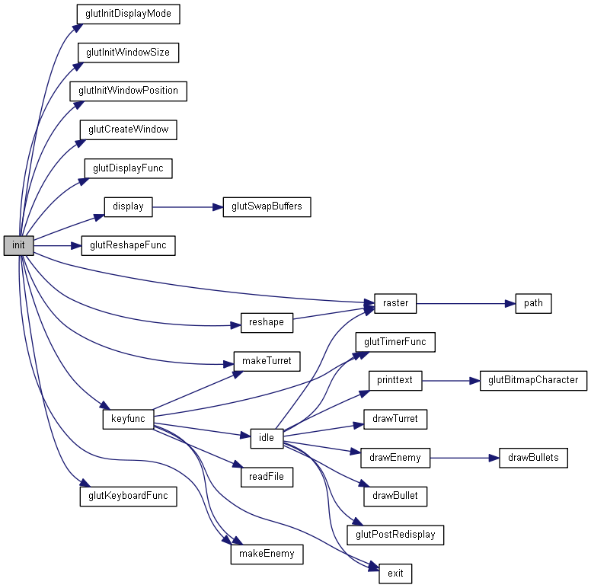
Overview of the
Main code : Important difference between GLUT functions
And own functions
Overview Code I Main

Slide 5
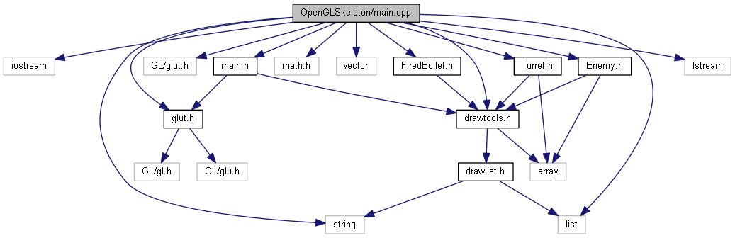
Includes of Main file:
Vector use instead of linked list
Overview || includes Main

Slide 6
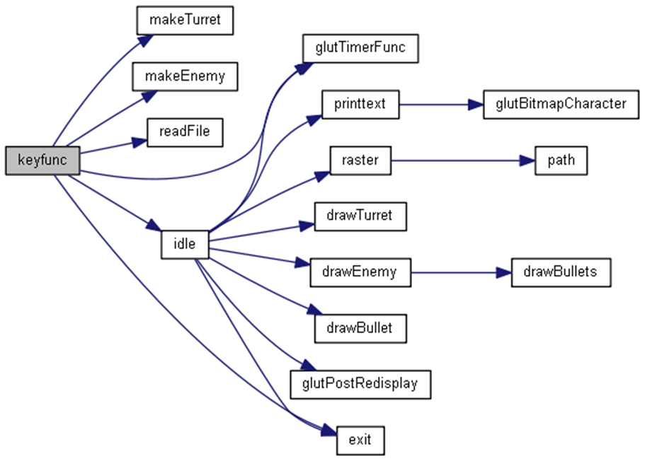
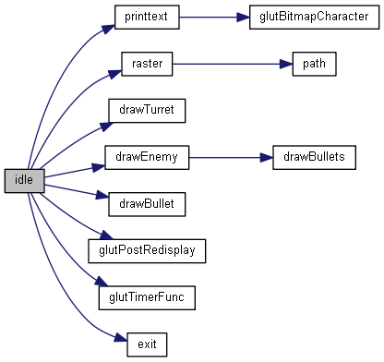
Important functions :
Idle(): Calculating the new positions of enemy’s, turret's and bullets
Keyfunc(): Spawns enemy’s and turret’s
Overview || functions Main

Slide 7
Exdented Part A using classes
Overview Code |||

Slide 8
Features

Slide 9
Tough features

Slide 10
Improvements

